Slide 1
The Foundations: Logic and Proofs
Chapter 1, Part II: Predicate Logic
With Question/Answer Animations
© 2019 McGraw-Hill Education. All rights reserved. Authorized only for instructor use in the classroom. No reproduction or further distribution permitted without the prior written consent of McGraw-Hill Education.

Slide 2
Summary
Predicate Logic (First-Order Logic (FOL), Predicate Calculus)
The Language of Quantifiers
Logical Equivalences
Nested Quantifiers
Translation from Predicate Logic to English
Translation from English to Predicate Logic

Slide 3
Predicates and Quantifiers
Section 1.4

Slide 4
Section Summary 1
Predicates
Variables
Quantifiers
Universal Quantifier
Existential Quantifier
Negating Quantifiers
De Morgan’s Laws for Quantifiers
Translating English to Logic
Logic Programming (optional)

Slide 5
Propositional Logic Not Enough
If we have:
“All men are mortal.”
“Socrates is a man.”
Does it follow that “Socrates is mortal?”
Can’t be represented in propositional logic. Need a language that talks about objects, their properties, and their relations.
Later we’ll see how to draw inferences.

Slide 6
Introducing Predicate Logic
Predicate logic uses the following new features:
Variables: x, y, z
Predicates: P(x), M(x)
Quantifiers (to be covered in a few slides):
Propositional functions are a generalization of propositions.
They contain variables and a predicate, e.g., P(x)
Variables can be replaced by elements from their domain.

Slide 7
Propositional Functions
Propositional functions become propositions (and have truth values) when their variables are each replaced by a value from the domain (or bound by a quantifier, as we will see later).
The statement P(x) is said to be the value of the propositional function P at x.
For example, let P(x) denote “x > 0” and the domain be the integers. Then:
P(-3) is false.
P(0) is false.
P(3) is true.
Often the domain is denoted by U. So in this example U is the integers.

Slide 8
Examples of Propositional Functions
Let “x + y = z” be denoted by R(x, y, z) and U (for all three variables) be the integers. Find these truth values:
R(2,-1,5)
Solution: F
R(3,4,7)
Solution: T
R(x, 3, z)
Solution: Not a Proposition
Now let “x - y = z” be denoted by Q(x, y, z), with U as the integers. Find these truth values:
Q(2,-1,3)
Solution: T
Q(3,4,7)
Solution: F
Q(x, 3, z)
Solution: Not a Proposition

Slide 9
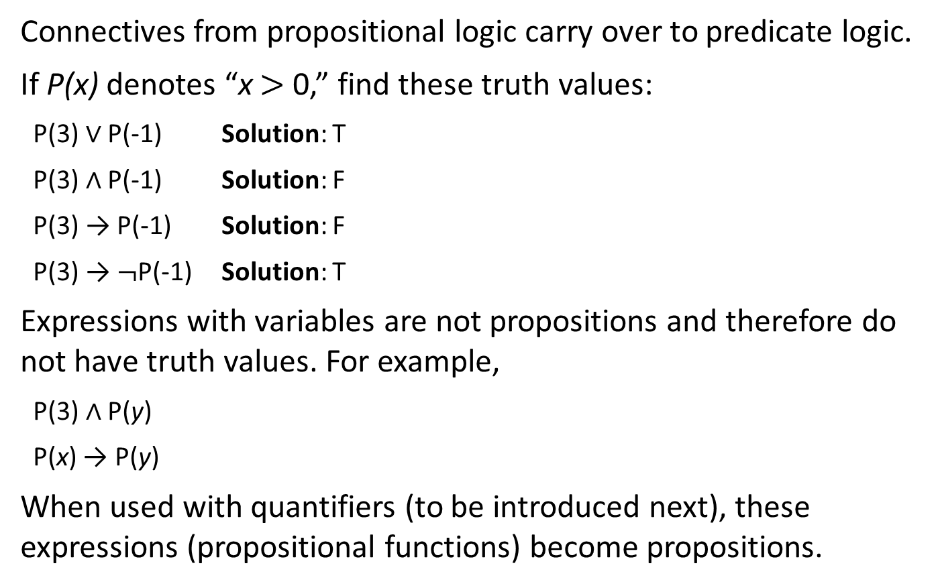
Compound Expressions
Connectives from propositional logic carry over to predicate logic.
If P(x) denotes “x $>$ 0,” find these truth values:
P(3) ∨ P(-1) Solution: T
P(3) ∧ P(-1) Solution: F
P(3) → P(-1) Solution: F
P(3) → $¬$P(-1) Solution: T
Expressions with variables are not propositions and therefore do not have truth values. For example,
P(3) ∧ P(y)
P(x) → P(y)
When used with quantifiers (to be introduced next), these expressions (propositional functions) become propositions.

Slide 10
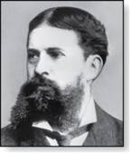
Quantifiers
Charles Peirce (1839-1914)
We need quantifiers to express the meaning of English words including all and some:
“All men are Mortal.”
“Some cats do not have fur.”
The two most important quantifiers are:
Universal Quantifier, “For all,” symbol: ∀
Existential Quantifier, “There exists,” symbol: ∃
We write as in ∀x P(x) and ∃x P(x).
∀x P(x) asserts P(x) is true for every x in the domain.
∃x P(x) asserts P(x) is true for some x in the domain.
The quantifiers are said to bind the variable x in these expressions.

Slide 11
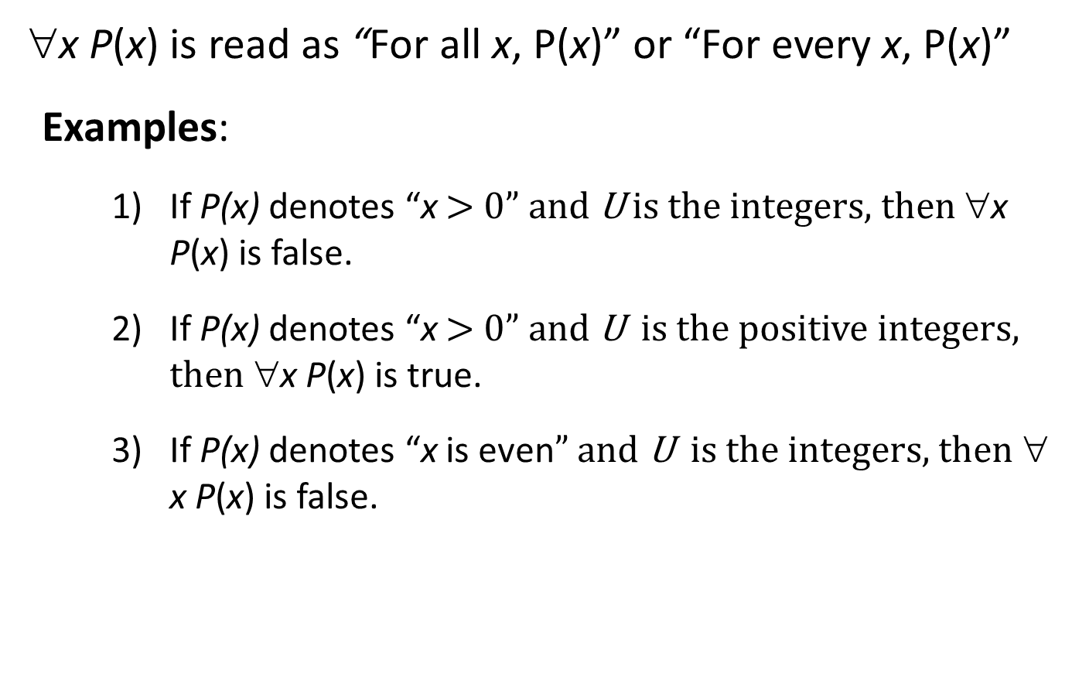
Universal Quantifier
∀x P(x) is read as “For all x, P(x)” or “For every x, P(x)”
Examples:
If P(x) denotes “x $>$ 0” and U is the integers, then ∀x P(x) is false.
If P(x) denotes “x $>$ 0” and U is the positive integers, then ∀x P(x) is true.
If P(x) denotes “x is even” and U is the integers, then ∀ x P(x) is false.

Slide 12
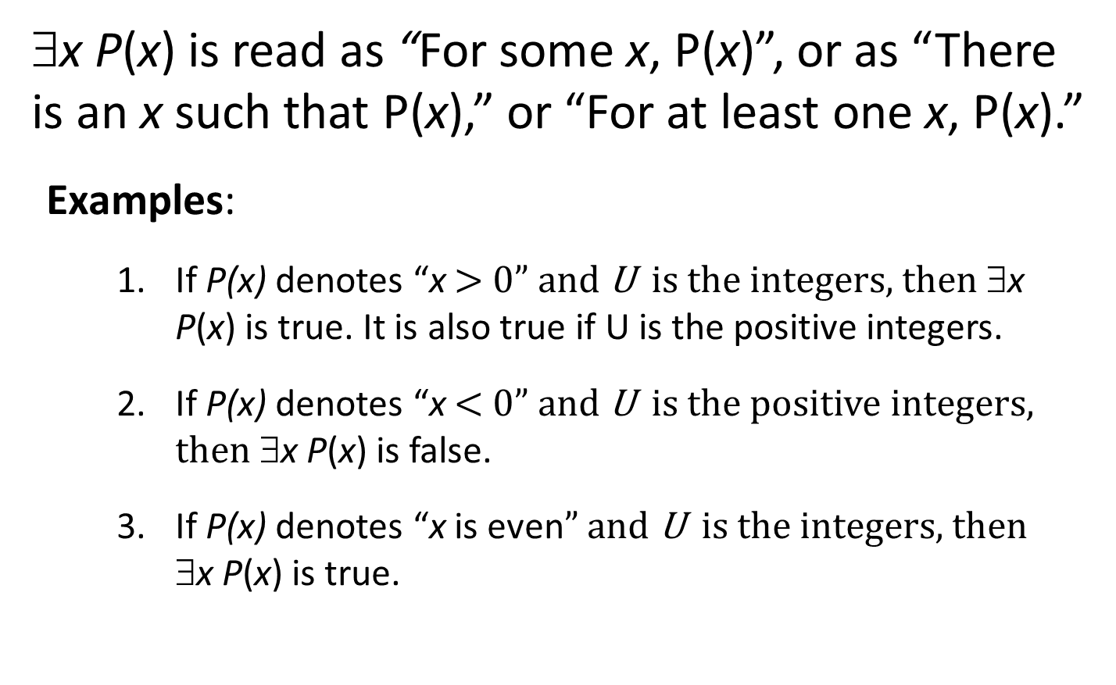
Existential Quantifier
∃x P(x) is read as “For some x, P(x)”, or as “There is an x such that P(x),” or “For at least one x, P(x).”
Examples:
If P(x) denotes “x $>$ 0” and U is the integers, then ∃x P(x) is true. It is also true if U is the positive integers.
If P(x) denotes “x $<$ 0” and U is the positive integers, then ∃x P(x) is false.
If P(x) denotes “x is even” and U is the integers, then ∃x P(x) is true.

Slide 13
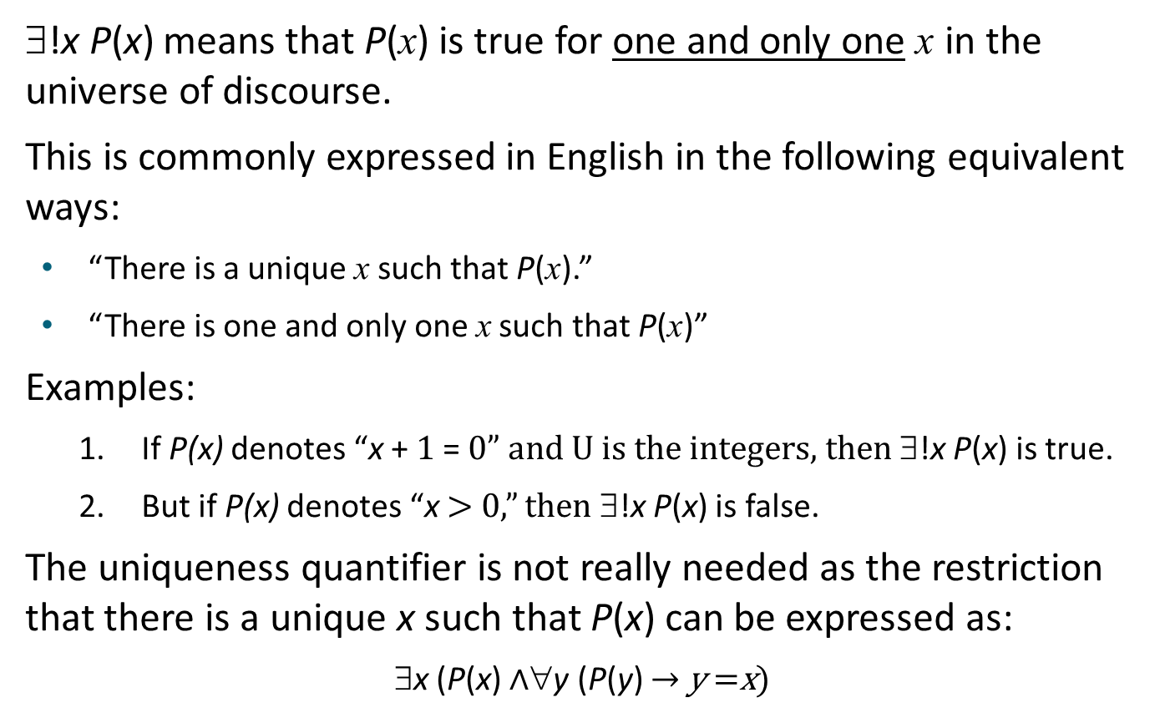
Uniqueness Quantifier (optional)
∃!x P(x) means that P(x) is true for one and only one x in the universe of discourse.
This is commonly expressed in English in the following equivalent ways:
“There is a unique x such that P(x).”
“There is one and only one x such that P(x)”
Examples:
If P(x) denotes “x + 1 = 0” and U is the integers, then ∃!x P(x) is true.
But if P(x) denotes “x $>$ 0,” then ∃!x P(x) is false.
The uniqueness quantifier is not really needed as the restriction that there is a unique x such that P(x) can be expressed as:
∃x (P(x) $∧$∀y (P(y) → y =x)

Slide 14
Thinking about Quantifiers
When the domain of discourse is finite, we can think of quantification as looping through the elements of the domain.
To evaluate ∀x P(x) loop through all x in the domain.
If at every step P(x) is true, then ∀x P(x) is true.
If at a step P(x) is false, then ∀x P(x) is false and the loop terminates.
To evaluate ∃x P(x) loop through all x in the domain.
If at some step, P(x) is true, then ∃x P(x) is true and the loop terminates.
If the loop ends without finding an x for which P(x) is true, then ∃x P(x) is false.
Even if the domains are infinite, we can still think of the quantifiers this fashion, but the loops will not terminate in some cases.

Slide 15
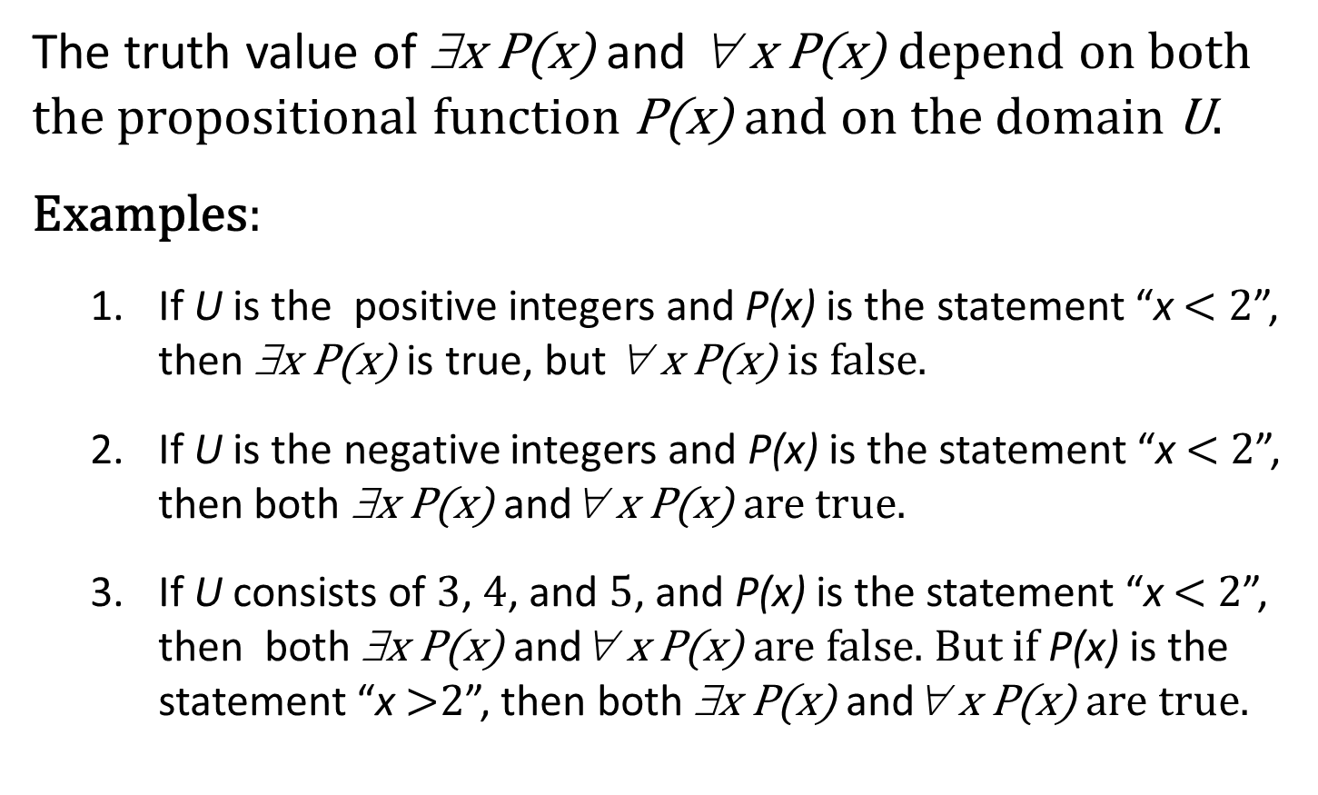
Properties of Quantifiers
The truth value of ∃x P(x) and ∀ x P(x) depend on both the propositional function P(x) and on the domain U.
Examples:
If U is the positive integers and P(x) is the statement “x $<$ 2”, then ∃x P(x) is true, but ∀ x P(x) is false.
If U is the negative integers and P(x) is the statement “x $<$ 2”, then both ∃x P(x) and∀ x P(x) are true.
If U consists of 3, 4, and 5, and P(x) is the statement “x $<$ 2”, then both ∃x P(x) and∀ x P(x) are false. But if P(x) is the statement “x $>$2”, then both ∃x P(x) and∀ x P(x) are true.

Slide 16
Precedence of Quantifiers
The quantifiers ∀ and ∃ have higher precedence than all the logical operators.
For example,∀x P(x)∨ Q(x) means (∀x P(x))∨ Q(x)
∀x (P(x)∨ Q(x)) means something different.
Unfortunately, often people write∀x P(x)∨ Q(x) when they mean∀ x (P(x) ∨ Q(x)).

Slide 17
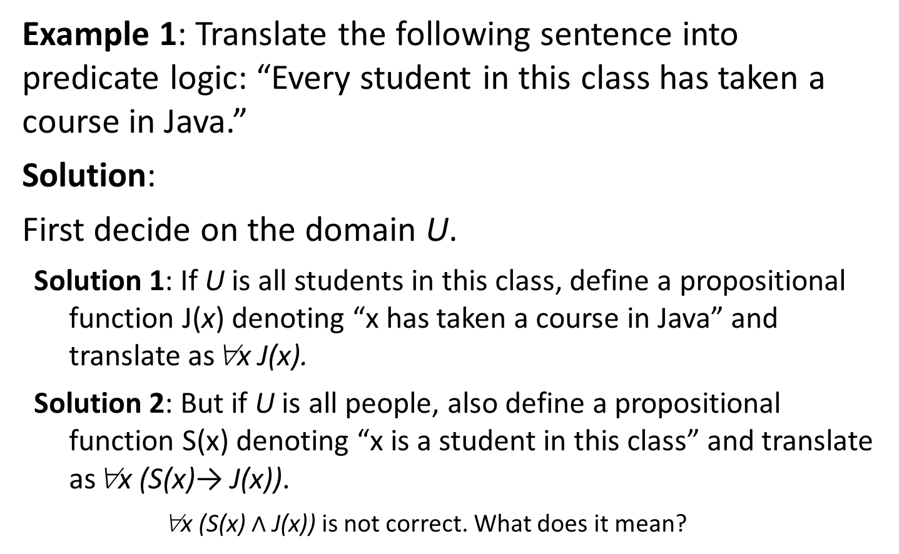
Translating from English to Logic 1
Example 1: Translate the following sentence into predicate logic: “Every student in this class has taken a course in Java.”
Solution:
First decide on the domain U.
Solution 1: If U is all students in this class, define a propositional function J(x) denoting “x has taken a course in Java” and translate as∀x J(x).
Solution 2: But if U is all people, also define a propositional function S(x) denoting “x is a student in this class” and translate as∀x (S(x)→ J(x)).
∀x (S(x) $∧$ J(x)) is not correct. What does it mean?

Slide 18
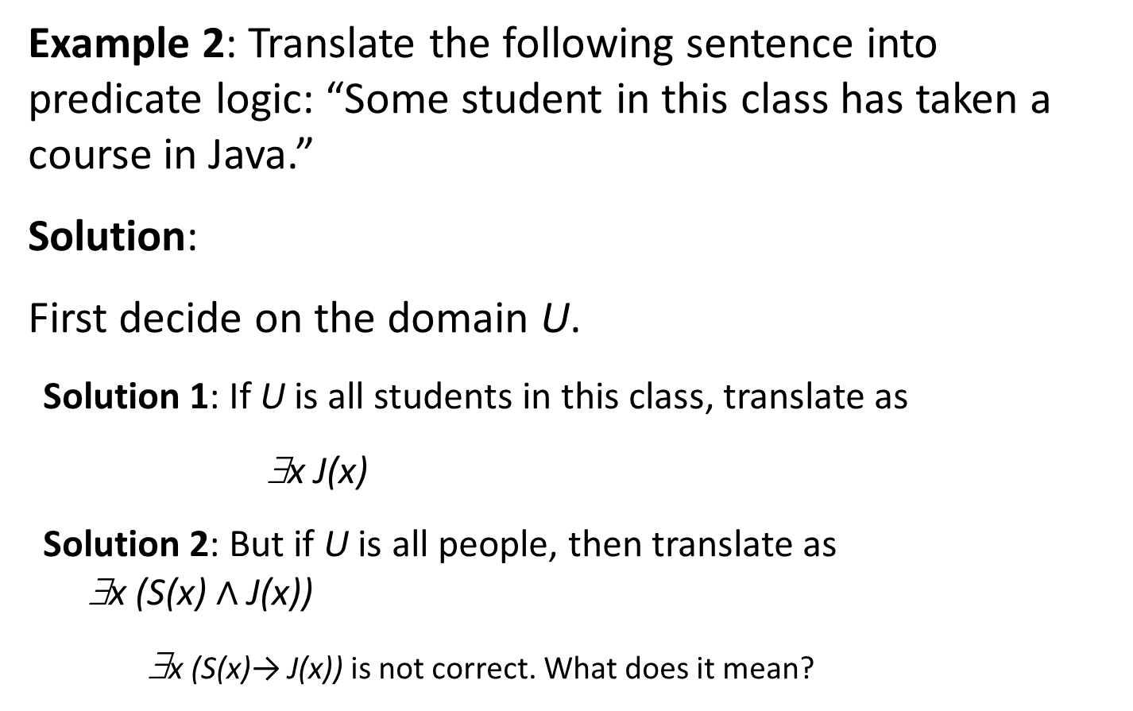
Translating from English to Logic 2
Example 2: Translate the following sentence into predicate logic: “Some student in this class has taken a course in Java.”
Solution:
First decide on the domain U.
Solution 1: If U is all students in this class, translate as
∃x J(x)
Solution 2: But if U is all people, then translate as ∃x (S(x) $∧$ J(x))
∃x (S(x)→ J(x)) is not correct. What does it mean?

Slide 19
Returning to the Socrates Example
Introduce the propositional functions Man(x) denoting “x is a man” and Mortal(x) denoting “x is mortal.” Specify the domain as all people.
The two premises are:
The conclusion is:
Later we will show how to prove that the conclusion follows from the premises.

Slide 20
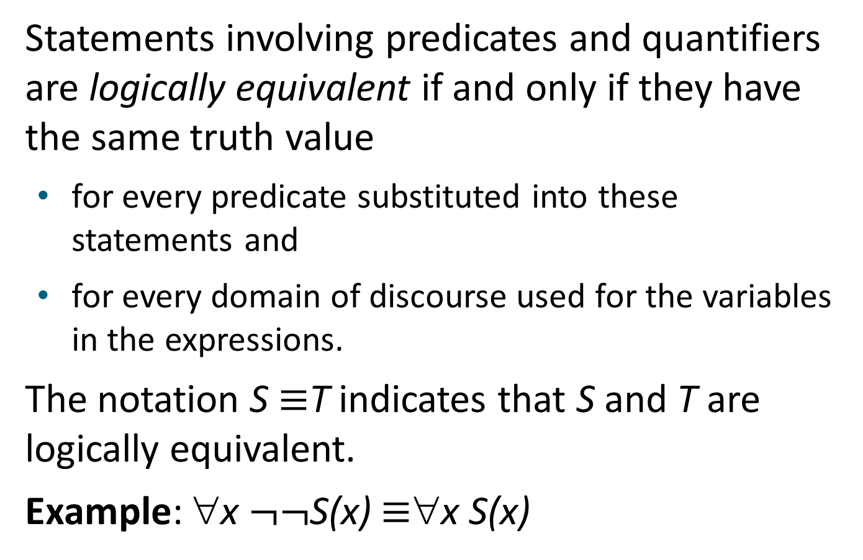
Equivalences in Predicate Logic
Statements involving predicates and quantifiers are logically equivalent if and only if they have the same truth value
for every predicate substituted into these statements and
for every domain of discourse used for the variables in the expressions.
The notation S $≡$T indicates that S and T are logically equivalent.
Example: ∀x $¬¬$S(x) $≡$∀x S(x)

Slide 21
Thinking about Quantifiers as Conjunctions and Disjunctions
If the domain is finite, a universally quantified proposition is equivalent to a conjunction of propositions without quantifiers and an existentially quantified proposition is equivalent to a disjunction of propositions without quantifiers.
If U consists of the integers 1,2, and 3:
Even if the domains are infinite, you can still think of the quantifiers in this fashion, but the equivalent expressions without quantifiers will be infinitely long.

Slide 22
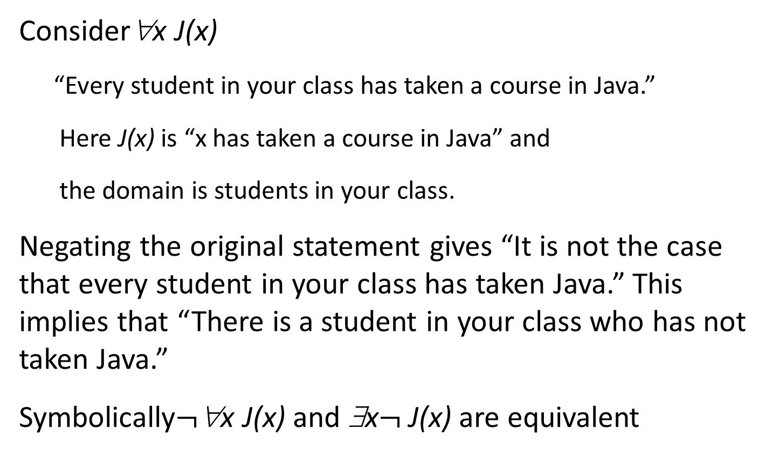
Negating Quantified Expressions 1
Consider∀x J(x)
“Every student in your class has taken a course in Java.”
Here J(x) is “x has taken a course in Java” and
the domain is students in your class.
Negating the original statement gives “It is not the case that every student in your class has taken Java.” This implies that “There is a student in your class who has not taken Java.”
Symbolically$¬$∀x J(x) and ∃x$¬$J(x) are equivalent

Slide 23
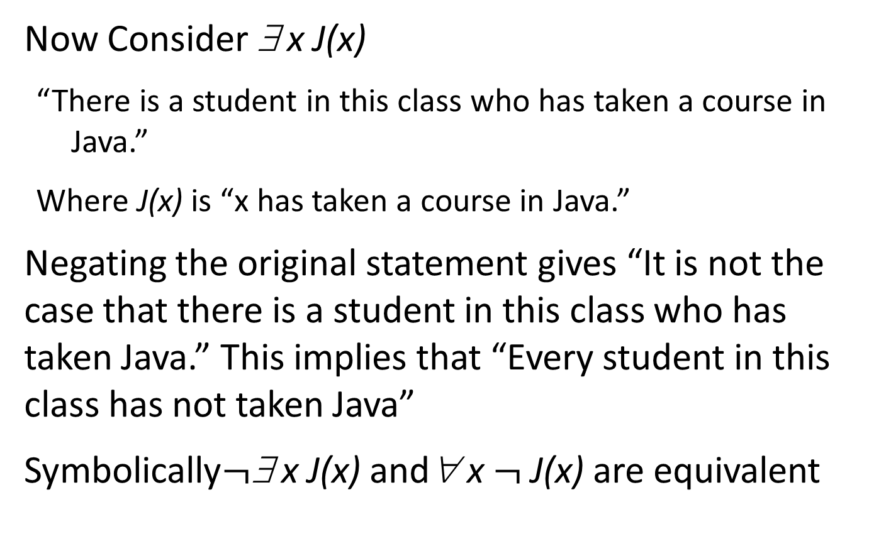
Negating Quantified Expressions 2
Now Consider ∃ x J(x)
“There is a student in this class who has taken a course in Java.”
Where J(x) is “x has taken a course in Java.”
Negating the original statement gives “It is not the case that there is a student in this class who has taken Java.” This implies that “Every student in this class has not taken Java”
Symbolically$¬$∃ x J(x) and∀ x $¬$J(x) are equivalent

Slide 24
De Morgan’s Laws for Quantifiers
The rules for negating quantifiers are:
TABLE 2 De Morgan’s Laws for Quantifiers.
Negation | Equivalent Statement | When Is Negation True? | When False?
 |  | For every x, P(x) is false. | There is x for which P(x) is true.
 |  | There is an x for which P (x) is false. | P(x) is true for every x.
The reasoning in the table shows that:
These are important. You will use these.

Slide 25
Translation from English to Logic
Examples:
“Some student in this class has visited Mexico.”
Solution: Let M(x) denote “x has visited Mexico” and S(x) denote “x is a student in this class,” and U be all people.
“Every student in this class has visited Canada or Mexico.”
Solution: Add C(x) denoting “x has visited Canada.”

Slide 26
Some Fun with Translating from English into Logical Expressions 1
U = {fleegles, snurds, thingamabobs}
F(x): x is a fleegle
S(x): x is a snurd
T(x): x is a thingamabob
Translate “Everything is a fleegle”
Solution: ∀x F(x)

Slide 27
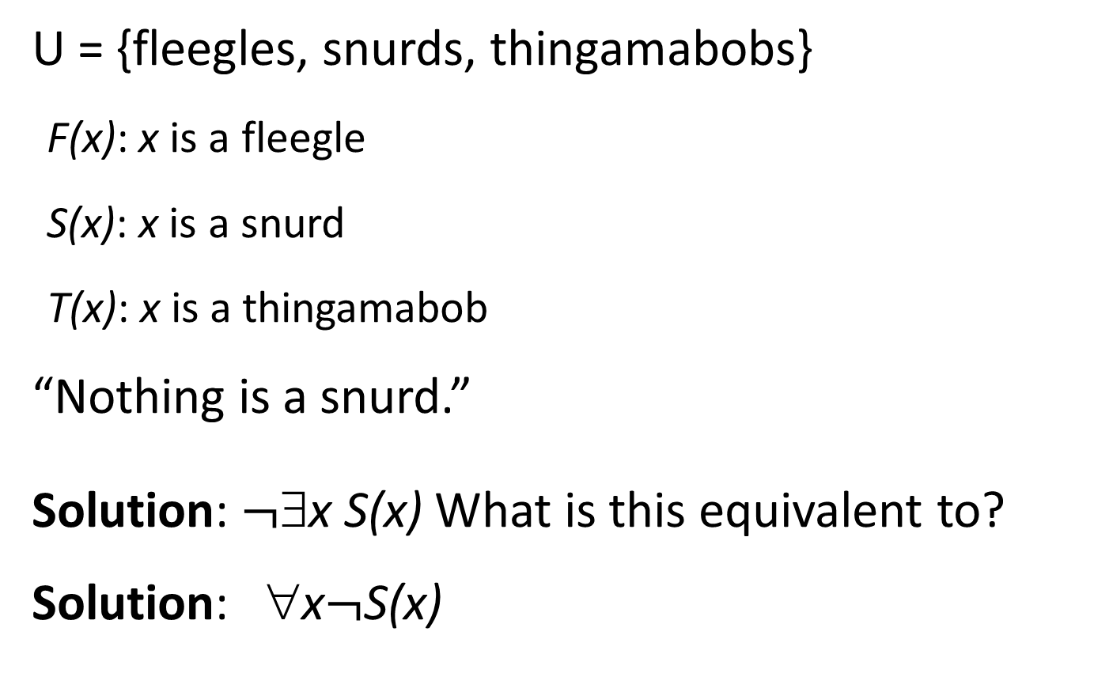
Some Fun with Translating from English into Logical Expressions 2
U = {fleegles, snurds, thingamabobs}
F(x): x is a fleegle
S(x): x is a snurd
T(x): x is a thingamabob
“Nothing is a snurd.”
Solution: $¬$∃x S(x) What is this equivalent to?
Solution: ∀x$¬$S(x)

Slide 28
Some Fun with Translating from English into Logical Expressions 3
U = {fleegles, snurds, thingamabobs}
F(x): x is a fleegle
S(x): x is a snurd
T(x): x is a thingamabob
“All fleegles are snurds.”
Solution:

Slide 29
Some Fun with Translating from English into Logical Expressions 4
U = {fleegles, snurds, thingamabobs}
F(x): x is a fleegle
S(x): x is a snurd
T(x): x is a thingamabob
“Some fleegles are thingamabobs.”
Solution:

Slide 30
Some Fun with Translating from English into Logical Expressions 5
U = {fleegles, snurds, thingamabobs}
F(x): x is a fleegle
S(x): x is a snurd
T(x): x is a thingamabob
“No snurd is a thingamabob.”
Solution:
What is this equivalent to?
Solution:

Slide 31
Some Fun with Translating from English into Logical Expressions 6
U = {fleegles, snurds, thingamabobs}
F(x): x is a fleegle
S(x): x is a snurd
T(x): x is a thingamabob
“If any fleegle is a snurd then it is also a thingamabob.”
Solution:

Slide 32
System Specification Example
Predicate logic is used for specifying properties that systems must satisfy.
For example, translate into predicate logic:
“Every mail message larger than one megabyte will be compressed.”
“If a user is active, at least one network link will be available.”
Decide on predicates and domains (left implicit here) for the variables:
Let L(m, y) be “Mail message m is larger than y megabytes.”
Let C(m) denote “Mail message m will be compressed.”
Let A(u) represent “User u is active.”
Let S(n, x) represent “Network link n is state x.
Now we have:

Slide 33
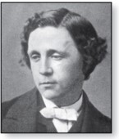
Lewis Carroll Example
Charles Lutwidge Dodgson (AKA Lewis Caroll) (1832-1898)
The first two are called premises and the third is called the conclusion.
“All lions are fierce.”
“Some lions do not drink coffee.”
“Some fierce creatures do not drink coffee.”
Here is one way to translate these statements to predicate logic. Let P(x), Q(x), and R(x) be the propositional functions “x is a lion,” “x is fierce,” and “x drinks coffee,” respectively.
Later we will see how to prove that the conclusion follows from the premises

Slide 34
Some Predicate Calculus Definitions (optional)
An assertion involving predicates and quantifiers is valid if it is true
for all domains
every propositional function substituted for the predicates in the assertion.
Example:
An assertion involving predicates is satisfiable if it is true
for some domains
some propositional functions that can be substituted for the predicates in the assertion.
Otherwise it is unsatisfiable.
Example:
not valid but satisfiable
Example:
unsatisfiable

Slide 35
MorePredicate Calculus Definitions (optional)
The scope of a quantifier is the part of an assertion in which variables are bound by the quantifier.
Example:
x has wide scope
Example:
x has narrow scope

Slide 36
Logic Programming (optional) 1
Prolog (from Programming in Logic) is a programming language developed in the 1970s by researchers in artificial intelligence (AI).
Prolog programs include Prolog facts and Prolog rules.
As an example of a set of Prolog facts consider the following:
instructor(chan, math273).
instructor(patel, ee222).
instructor(grossman, cs301).
enrolled(kevin, math273).
enrolled(juana, ee222).
enrolled(juana, cs301).
enrolled(kiko, math273).
enrolled(kiko, cs301).
Here the predicates instructor(p,c) and enrolled(s,c) represent that professor p is the instructor of course c and that student s is enrolled in course c.

Slide 37
Logic Programming (optional) 2
In Prolog, names beginning with an uppercase letter are variables.
If we have a predicate teaches(p,s) representing “professor p teaches student s,” we can write the rule:
teaches(P,S) :- instructor(P,C), enrolled(S,C).
This Prolog rule can be viewed as equivalent to the following statement in logic (using our conventions for logical statements).

Slide 38
Logic Programming (optional) 3
Prolog programs are loaded into a Prolog interpreter. The interpreter receives queries and returns answers using the Prolog program.
For example, using our program, the following query may be given:
?enrolled(kevin,math273).
Prolog produces the response:
yes
Note that the ? is the prompt given by the Prolog interpreter indicating that it is ready to receive a query.

Slide 39
Logic Programming (optional) 4
The query:
?enrolled(X,math273).
produces the response:
X = kevin;
X = kiko;
no
The query:
?teaches(X,juana).
produces the response:
X = patel;
X = grossman;
no
The Prolog interpreter tries to find an instantiation for X. It does so and returns X = kevin. Then the user types the ; indicating a request for another answer. When Prolog is unable to find another answer it returns no.

Slide 40
Logic Programming (optional) 5
The query:
?teaches(chan,X).
produces the response:
X = kevin;
X = kiko;
no
A number of very good Prolog texts are available. Learn Prolog Now! is one such text with a free online version at http://www.learnprolognow.org/
There is much more to Prolog and to the entire field of logic programming.

Slide 41
Nested Quantifiers
Section 1.5

Slide 42
Section Summary 2
Nested Quantifiers
Order of Quantifiers
Translating from Nested Quantifiers into English
Translating Mathematical Statements into Statements involving Nested Quantifiers.
Translated English Sentences into Logical Expressions.
Negating Nested Quantifiers.

Slide 43
Nested Quantifiers
Nested quantifiers are often necessary to express the meaning of sentences in English as well as important concepts in computer science and mathematics.
Example: “Every real number has an inverse” is
∀x ∃y(x + y = 0)
where the domains of x and y are the real numbers.
We can also think of nested propositional functions:
∀x ∃y(x + y = 0) can be viewed as ∀x Q(x) where Q(x) is ∃y P(x, y) where P(x, y) is (x + y = 0)

Slide 44
Thinking of Nested Quantification
Nested Loops
To see if ∀x∀yP (x,y) is true, loop through the values of x :
At each step, loop through the values for y.
If for some pair of x andy, P(x,y) is false, then ∀x ∀yP(x,y) is false and both the outer and inner loop terminate.
∀x ∀y P(x,y) is true if the outer loop ends after stepping through each x.
To see if ∀x ∃yP(x,y) is true, loop through the values of x:
At each step, loop through the values for y.
The inner loop ends when a pair x and y is found such that P(x, y) is true.
If no y is found such that P(x, y) is true the outer loop terminates as ∀x ∃yP(x,y) has been shown to be false.
∀x ∃y P(x,y) is true if the outer loop ends after stepping through each x.
If the domains of the variables are infinite, then this process can not actually be carried out.

Slide 45
Order of Quantifiers
Examples:
Let P(x,y) be the statement “x + y = y + x.” Assume that U is the real numbers. Then ∀x ∀yP(x,y) and ∀y ∀xP(x,y) have the same truth value.
Let Q(x,y) be the statement “x + y = 0.” Assume that U is the real numbers. Then ∀x ∃yQ(x,y) is true, but ∃y ∀xQ(x,y) is false.

Slide 46
Questions on Order of Quantifiers 1
Example 1: Let U be the real numbers,
Define P(x,y) : x ∙ y = 0
What is the truth value of the following:

Slide 47
Questions on Order of Quantifiers 2
Example 2: Let U be the real numbers,
Define P(x,y) : x / y = 1
What is the truth value of the following:

Slide 48
Quantifications of Two Variables
Statement | When True? | When False
 | P(x,y) is true for every pair x,y. | There is a pair x, y for which P(x,y) is false.
 | For every x there is a y for which P(x,y) is true. | There is an x such that P(x,y) is false for every y.
 | There is an x for which P(x,y) is true for every y. | For every x there is a y for which P(x,y) is false.
 | There is a pair x, y for which P(x,y) is true. | P(x,y) is false for every pair x,y

Slide 49
Translating Nested Quantifiers into English
Example 1: Translate the statement
where C(x) is “x has a computer,” and F(x,y) is “x and y are friends,” and the domain for both x and y consists of all students in your school.
Solution: Every student in your school has a computer or has a friend who has a computer.
Example 2: Translate the statement
Solution: There is a student none of whose friends are also friends with each other.

Slide 50
Translating Mathematical Statements into Predicate Logic
Example : Translate “The sum of two positive integers is always positive” into a logical expression.
Solution:
Rewrite the statement to make the implied quantifiers and domains explicit: “For every two integers, if these integers are both positive, then the sum of these integers is positive.”
Introduce the variables x and y, and specify the domain, to obtain: “For all positive integers x and y, x + y is positive.”
The result is:
where the domain of both variables consists of all integers

Slide 51
Translating English into Logical Expressions Example
Example: Use quantifiers to express the statement “There is a woman who has taken a flight on every airline in the world.”
Solution:
Let P(w,f) be “w has taken f ” and Q(f,a) be “f is a flight on a .”
The domain of w is all women, the domain of f is all flights, and the domain of a is all airlines.
Then the statement can be expressed as:

Slide 52
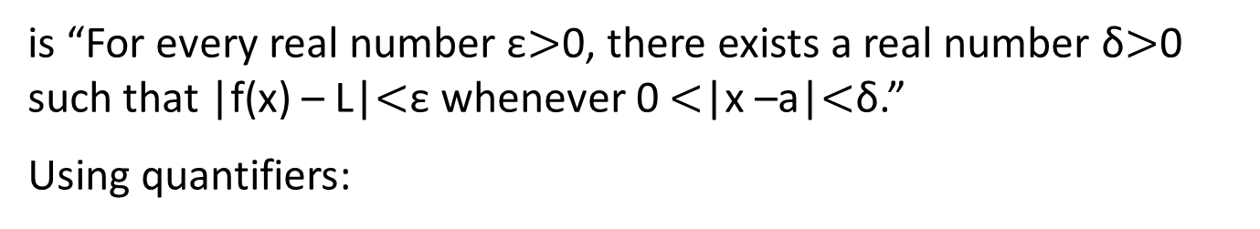
Calculus in Logic (optional)
Example: Use quantifiers to express the definition of the limit of a real-valued function f(x) of a real variable x at a point a in its domain.
Solution: Recall the definition of the statement
is “For every real number ε$>$0, there exists a real number δ$>$0 such that |f(x) – L|$<$ε whenever 0 $<$|x –a|$<$δ.”
Using quantifiers:
Where the domain for the variables ε and δ consists of all positive real numbers and the domain for x consists of all real numbers.

Slide 53
Questions on Translation from English
Choose the obvious predicates and express in predicate logic.
Example 1: “Brothers are siblings.”
Solution: ∀x ∀y (B(x,y) → S(x,y))
Example 2: “Siblinghood is symmetric.”
Solution: ∀x ∀y (S(x,y) → S(y,x))
Example 3: “Everybody loves somebody.”
Solution: ∀x ∃y L(x,y)
Example 4: “There is someone who is loved by everyone.”
Solution: ∃y ∀x L(x,y)
Example 5: “There is someone who loves someone.”
Solution: ∃x ∃y L(x,y)
Example 6: “Everyone loves himself”
Solution: ∀x L(x,x)

Slide 54
Negating Nested Quantifiers
Example 1: Recall the logical expression developed three slides back:
Part 1: Use quantifiers to express the statement that “There does not exist a woman who has taken a flight on every airline in the world.”
Solution:
Part 2: Now use De Morgan’s Laws to move the negation as far inwards as possible.
Solution:a
by De Morgan’s for ∃
by De Morgan’s for ∀
by De Morgan’s for ∃
by De Morgan’s for ∧.
Part 3: Can you translate the result back into English?
Solution:
“For every woman there is an airline such that for all flights, this woman has not taken that flight or that flight is not on this airline”

Slide 55
Return to Calculus and Logic (Opt)
Example : Recall the logical expression developed in the calculus example three slides back. Use quantifiers and predicates to express that
does not exist.
We need to say that for all real numbers L,
The result from the previous example can be negated to yield:
Now we can repeatedly apply the rules for negating quantified expressions:
The last step uses the equivalence

Slide 56
Calculus in Predicate Logic (optional)
Therefore, to say that
does not exist means
that for all real numbers L,
csan be expressed as:
Remember that ε and δ range over all positive real numbers and x over all real numbers.
Translating back into English we have, for every real number L, there is a real number ε > 0, such that for every real number δ > 0, there exists a real number x such that

Slide 57
Some Questions about Quantifiers (optional)
Can you switch the order of quantifiers?
Is this a valid equivalence?
Solution: Yes! The left and the right side will always have the same truth value. The order in which x and y are picked does not matter.
Is this a valid equivalence?
Solution: No! The left and the right side may have different truth values for some propositional functions for P. Try “x + y = 0” for P(x,y) with U being the integers. The order in which the values of x and y are picked does matter.
Can you distribute quantifiers over logical connectives?
Is this a valid equivalence?
Solution: Yes! The left and the right side will always have the same truth value no matter what propositional functions are denoted by P(x) and Q(x).
Is this a valid equivalence?
Solution: No! The left and the right side may have different truth values. Pick “x is a fish” for P(x) and “x has scales” for Q(x) with the domain of discourse being all animals. Then the left side is false, because there are some fish that do not have scales. But the right side is true since not all animals are fish.

